Slide 1
The Foreign NGO Law:
What Official Data Do (and Don’t) Tell Us
Jessica Batke, Senior Editor, ChinaFile
Data cut-off: September 30, 2021

Slide 2
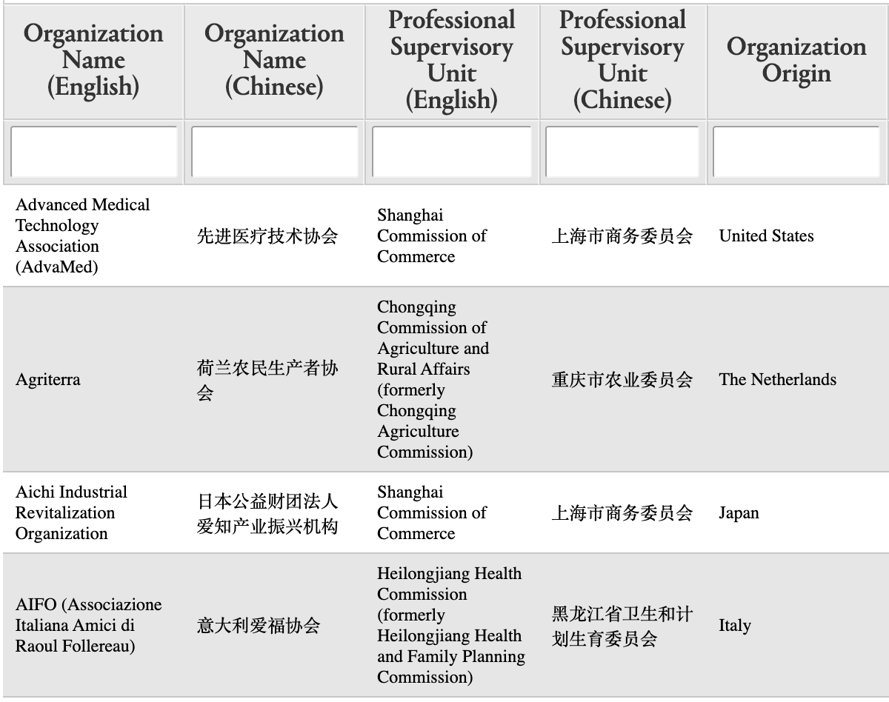
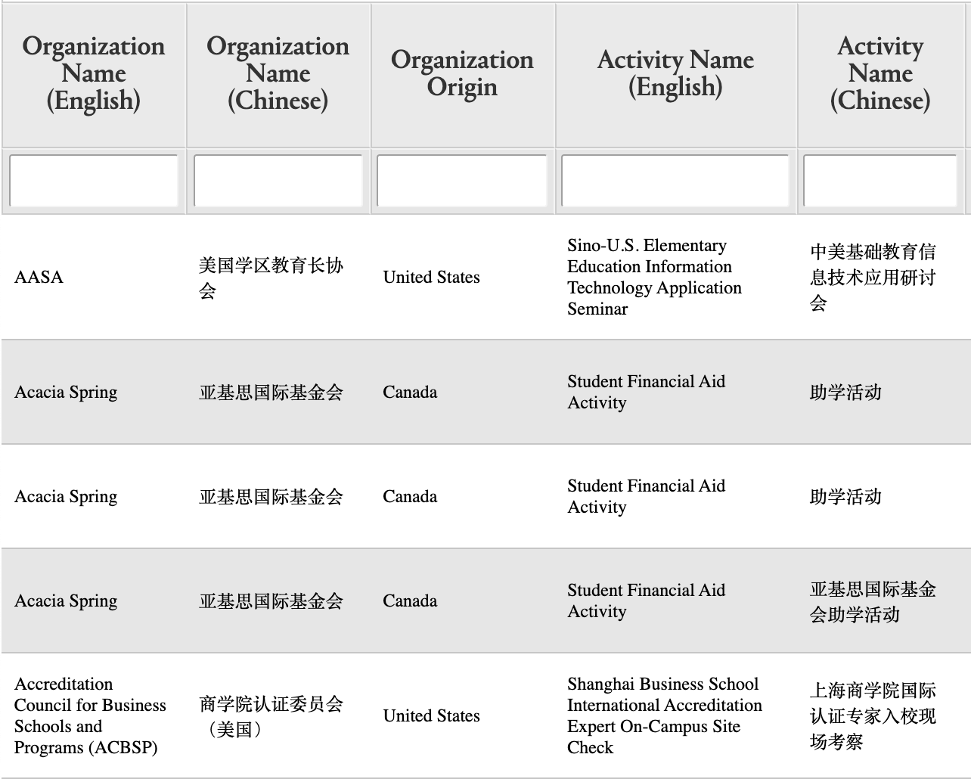
What Official Ministry of Public Security Data Tell Us
Which NGOs have successfully registered Representative Offices
Which NGOs have successfully filed for Temporary Activities

Slide 3
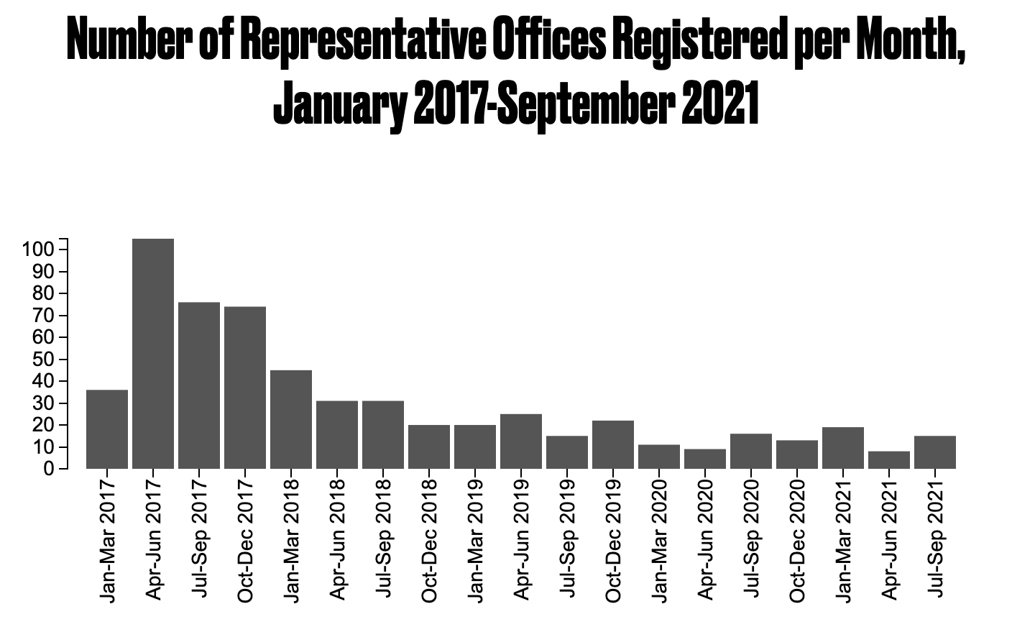
591 registrations total
Slow decline over time
Pandemic effects vs. settling out?

Slide 4
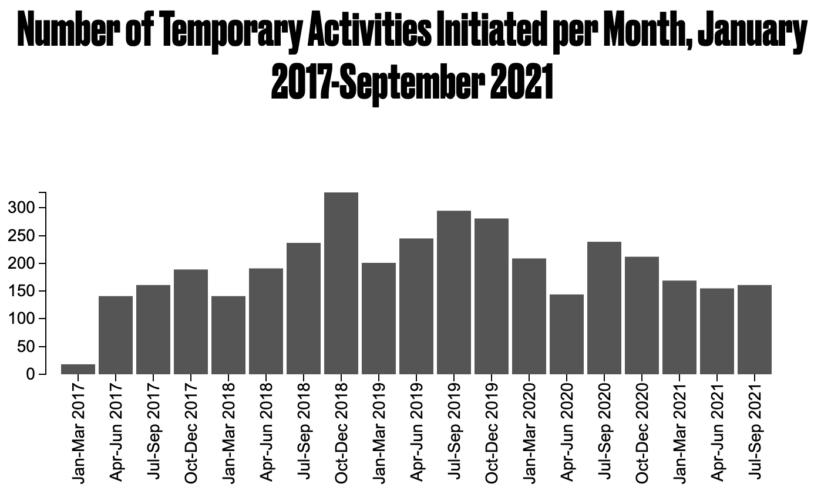
3,717 total filings
Slow decline since 2019
Pandemic effects vs. settling out?

Slide 5
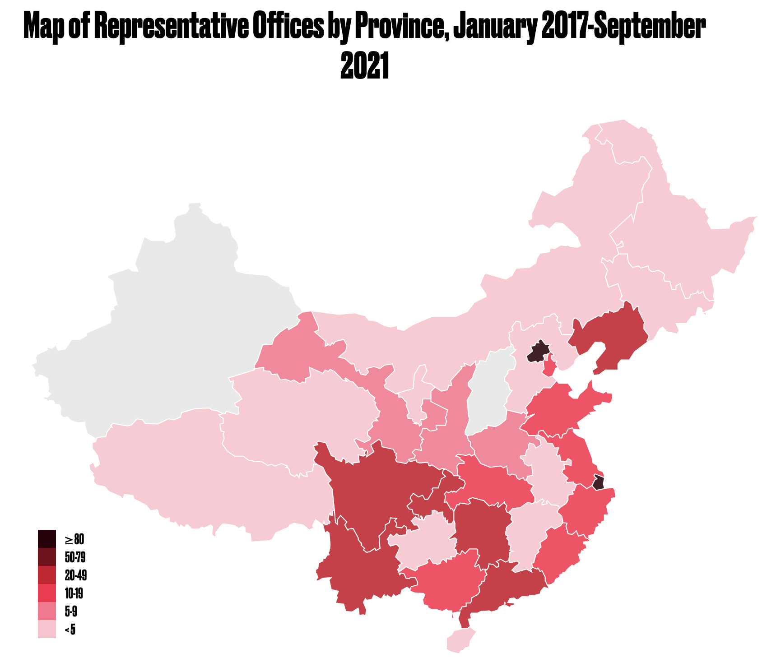
Wide range of registrations around the country
> 100 in Beijing, Shanghai
None in Shanxi, Xinjiang, Xinjiang Bingtuan

Slide 6
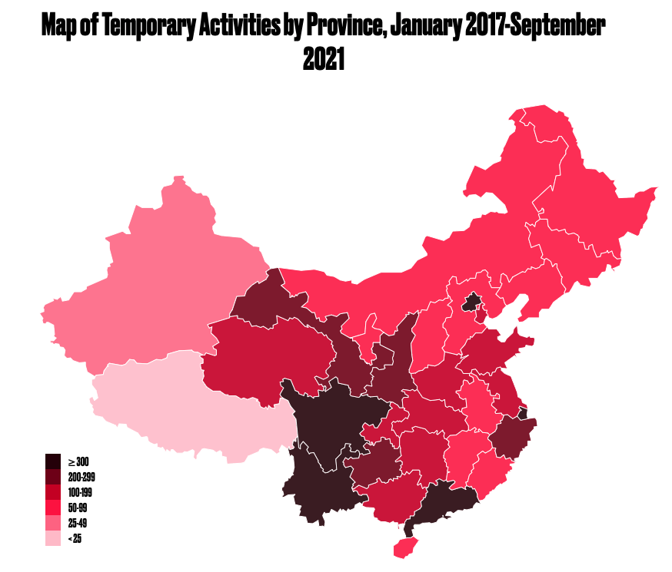
Slightly different mix of places people are working under “temporary activities”
> 1,000 activities in Guangdong province

Slide 7
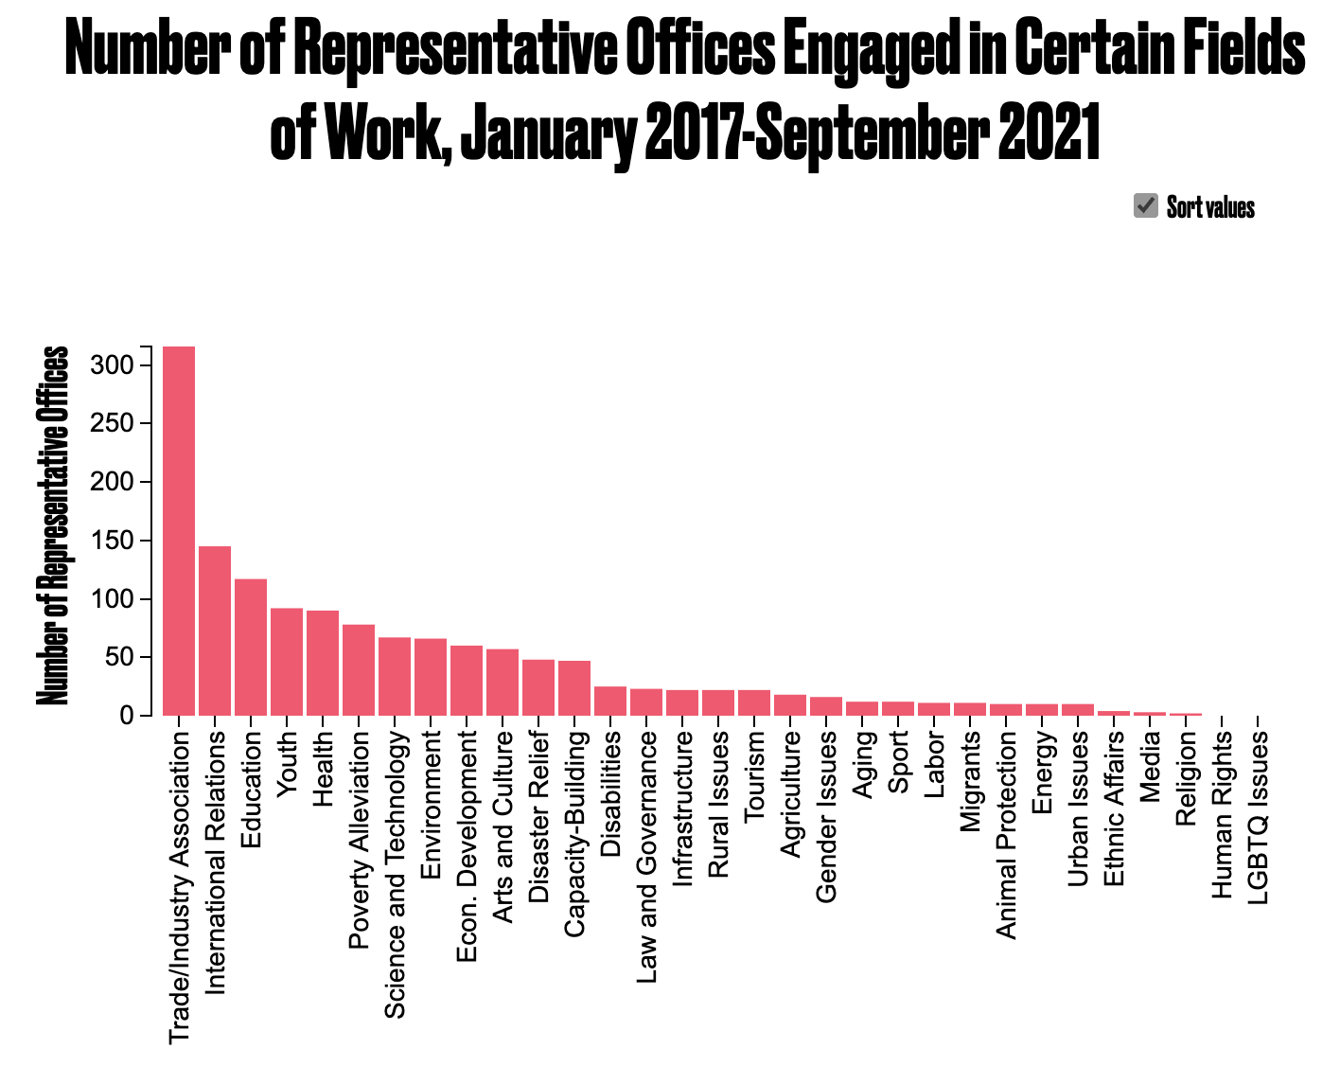
Over half of registered offices representing trade or industry interests

Slide 8
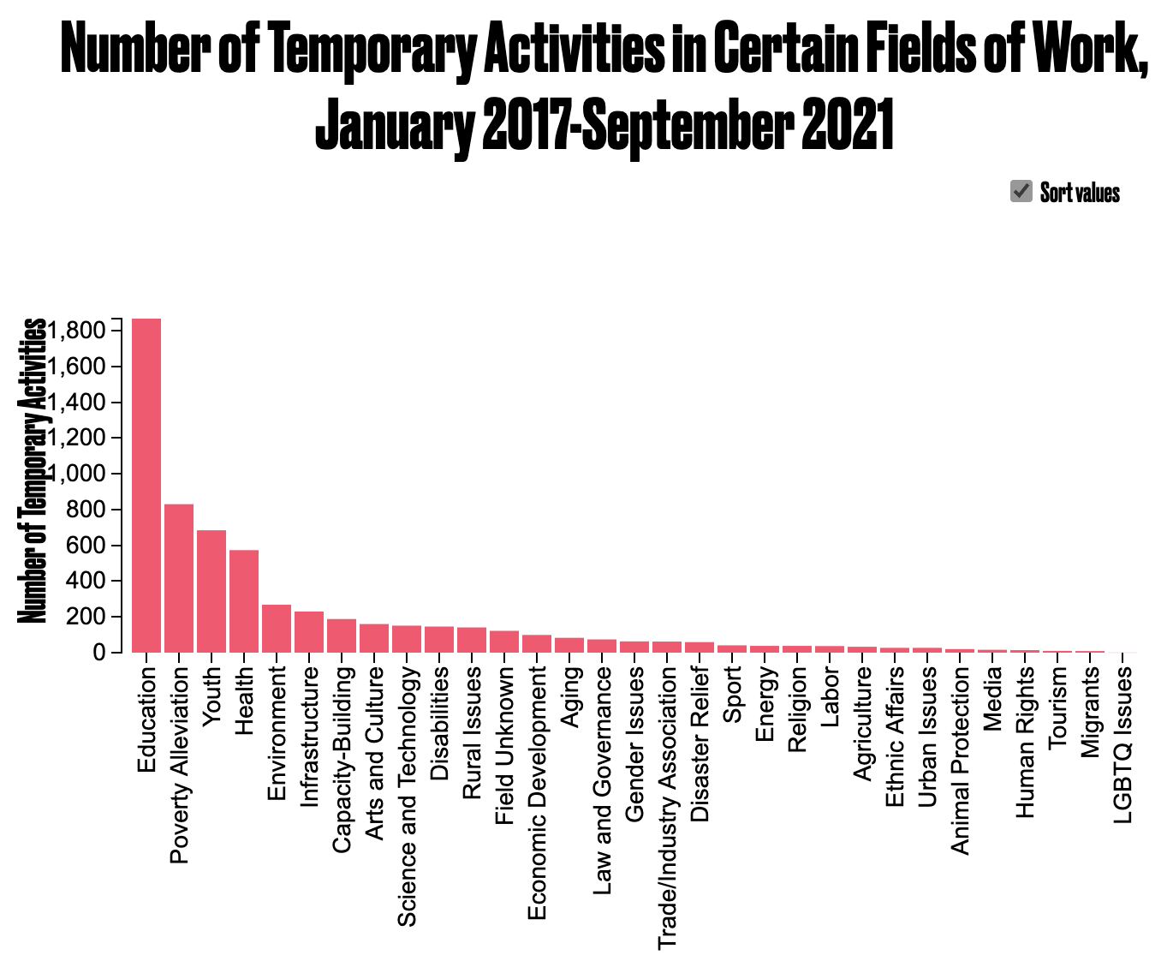
Just over half of activities education-related

Slide 9
What We Can Infer
Which types of work are preferred (education, trade) and which are discouraged (media, LGBTQ+)
Which provinces are interested in engaging with international NGOs

Slide 10
What Official Data Don’t Tell us
Which international NGOs applied or filed and were rejected. What sort of work do they do, where are they from, who were their proposed partners?
A comprehensive list of international NGOs that have left China since 2017, or who have decided against entering
A comprehensive list of domestic NGOs that have lost their international funders / partners
Pandemic effects vs. longer-term trends

Slide 11
chinafile.com/ngo

